Slide 1

“Financial Performance Analysis: Western countries Case Study”
Discovering Sales Stories Hidden in Western Market Trends.

Slide 2
SUMMARY OF DATASET
Dataset Overview
Total Records: 700 rows
Number of Columns: 16
Time Period Covered: 2013 to 2014
Geographic Scope: Various Western countries
Industry Focus: Bicycle manufacturing and sales
Key Data Fields: Includes details on customer segment, country, product, discount bands, units sold, pricing, gross and net sales, discounts applied, cost of goods sold (COGS), profit, and date-related fields.
Objective: To analyze sales and profit trends, identify top and bottom-performing products, evaluate segment-wise performance, and assess the impact of discounting strategies.

Slide 3
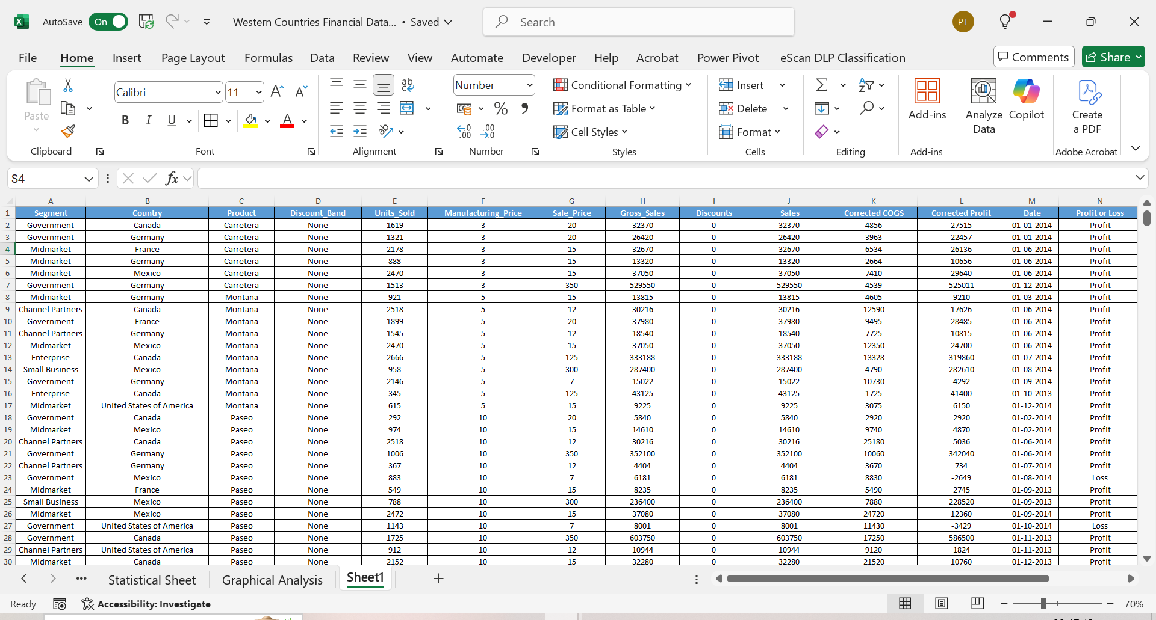
PERFORM DATA CLEANING IF REQUIRED AND THEN DO STATISTICAL ANALYSIS ON DATA USING STATISTICAL TOOLS.

Slide 4
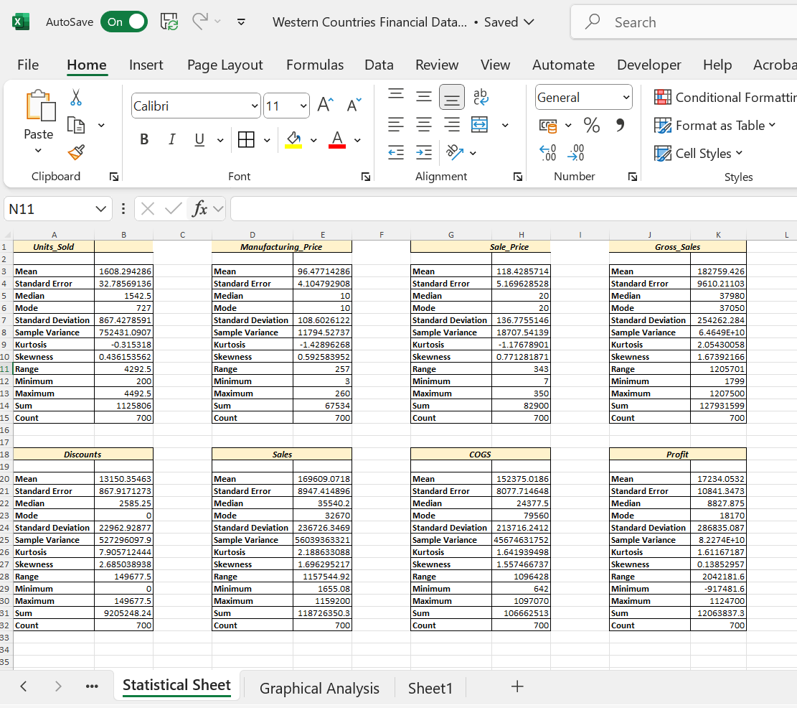
PERFORM DATA CLEANING IF REQUIRED AND THEN DO STATISTICAL ANALYSIS ON DATA USING STATISTICAL TOOLS.

Slide 5
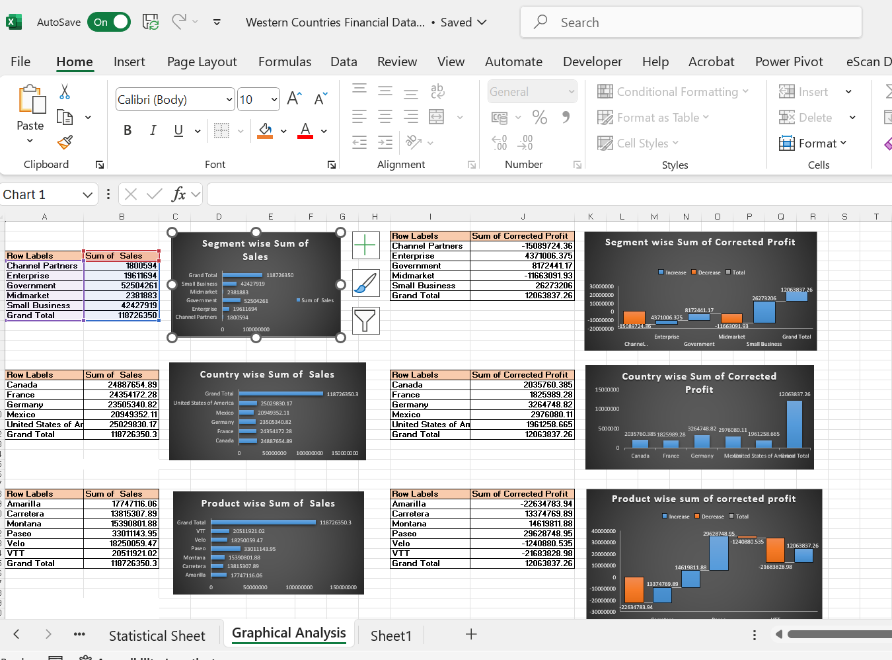
PERFORM GRAPHICAL ANALYSIS ON THE DATA USING EXCEL AND DERIVE INSIGHTS FROM IT.

Slide 6
Key Business Insights: Segments, Countries, and Products
The Enterprise segment leads in both sales and profitability, whereas the Government segment has the lowest sales but still maintains high profit margins.
Partners and Midmarket segments incur significant losses, indicating potential strategic or cost-related challenges. The USA achieves the highest sales but with lower profit margins, likely due to high operational costs or heavy discounting.
France demonstrates the strongest profitability despite lower sales, reflecting effective cost control. Mexico and Germany also show solid performance with healthy margins.
Paseo stands out as the top-selling and most profitable product, making a major contribution to overall profits. Montana earns a small profit, while Amarilla, Carretera, Velo, and VTT operate at a loss.
Among products, Amarilla and VTT experience the most substantial losses, calling for immediate corrective measures.
The presence of high sales but low profits in certain areas highlights the need for strategies to improve margins.
In conclusion, prioritizing profitable segments, countries, and products while addressing losses in underperforming areas can help maximize overall profitability.

Slide 7
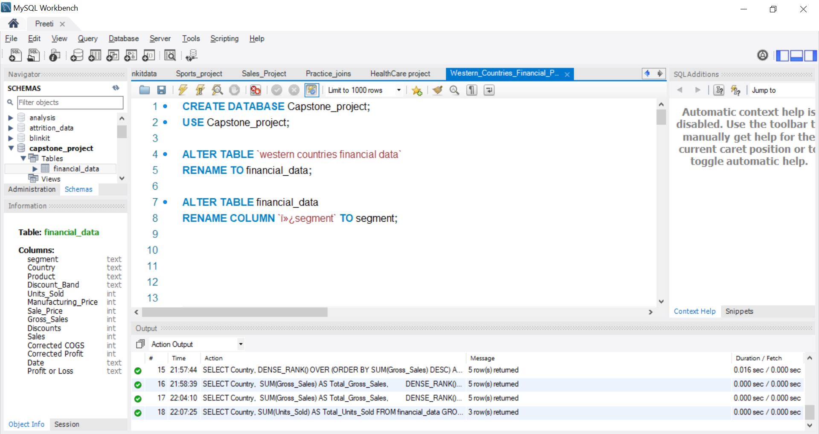
Insert the given data into the SQL server by making a Database and defining the required parameters for the construction of Database and Database tables.

Slide 8
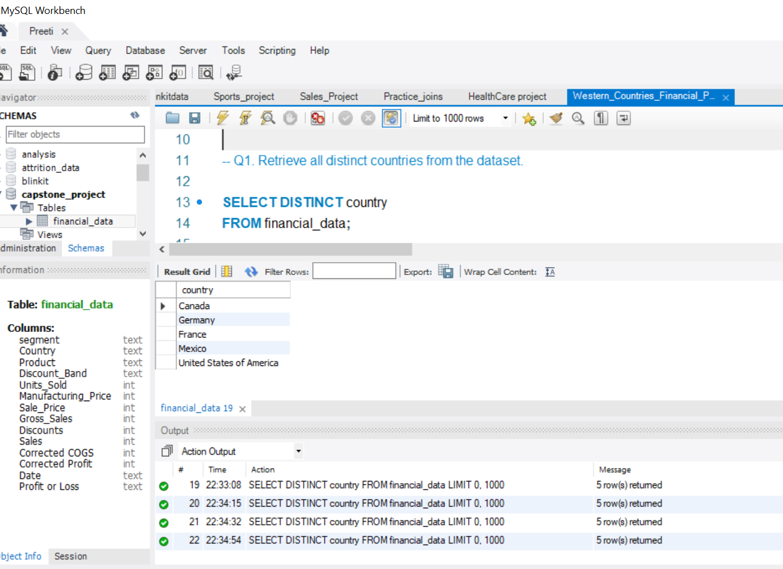
Verify if the data is properly imported into the SQL database (Try running few Queries)

Slide 9
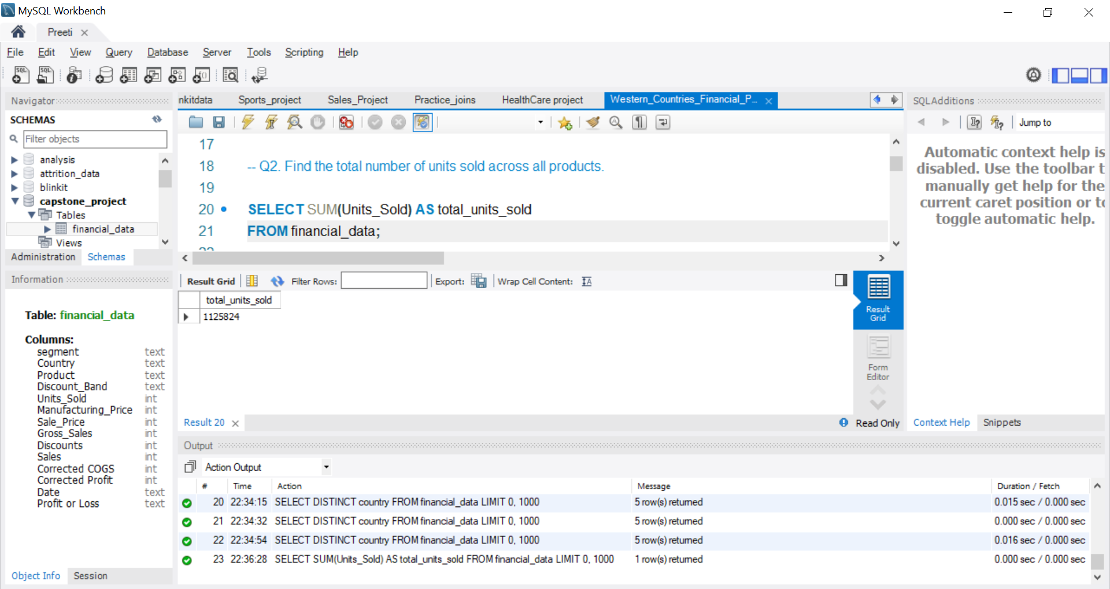

Slide 10
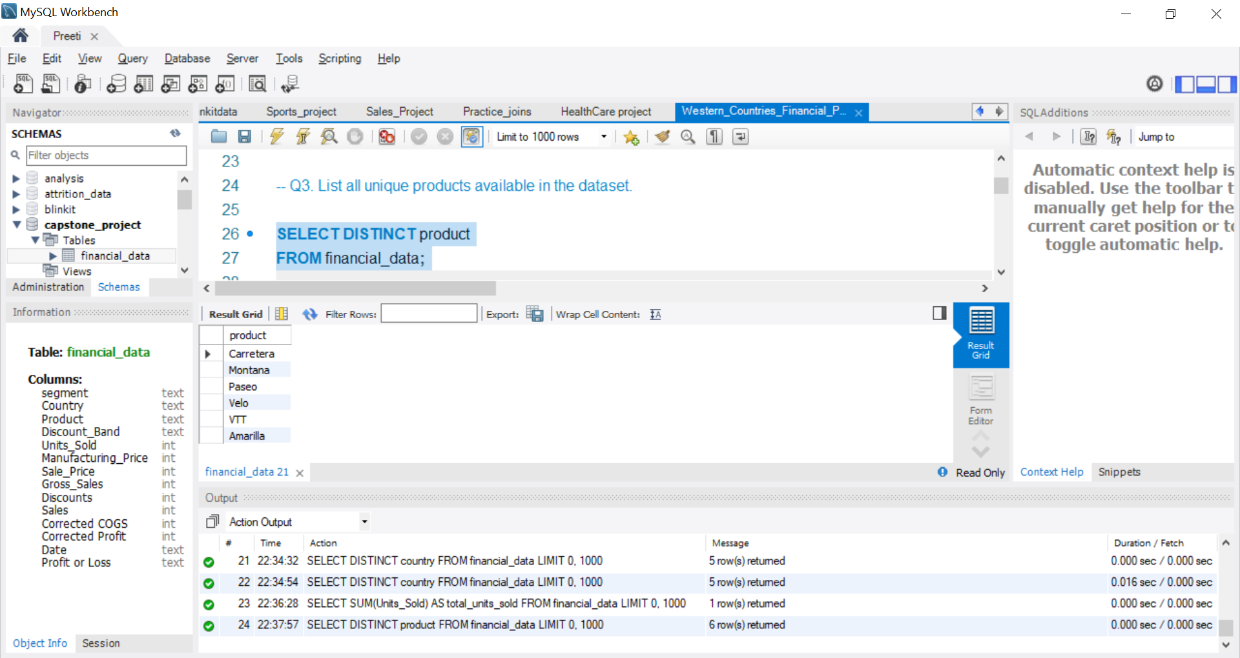

Slide 11
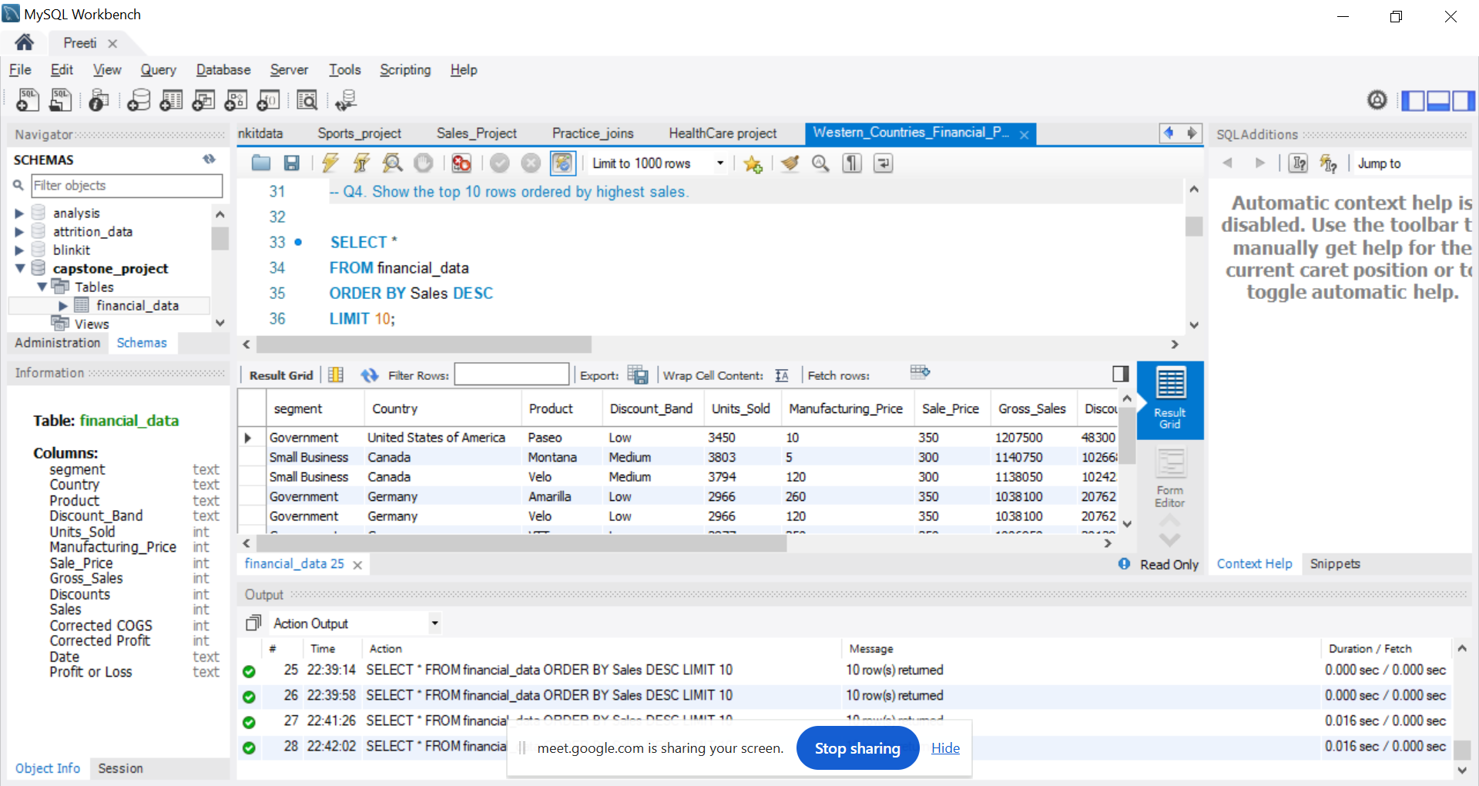

Slide 12
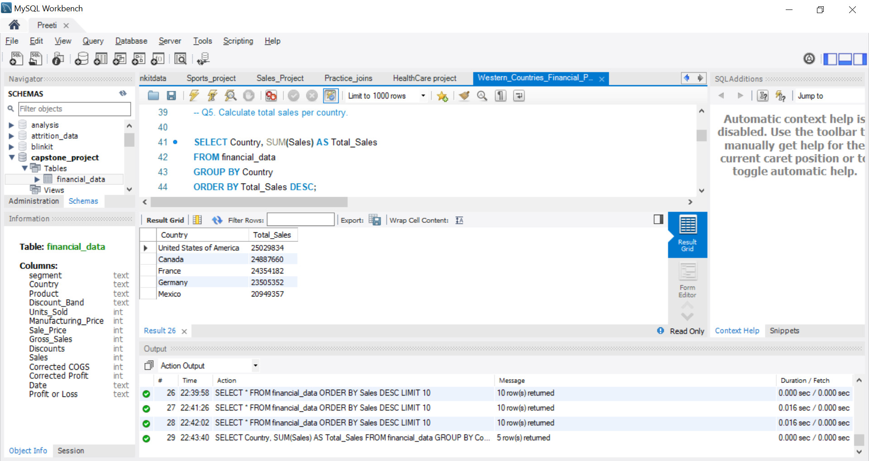

Slide 13
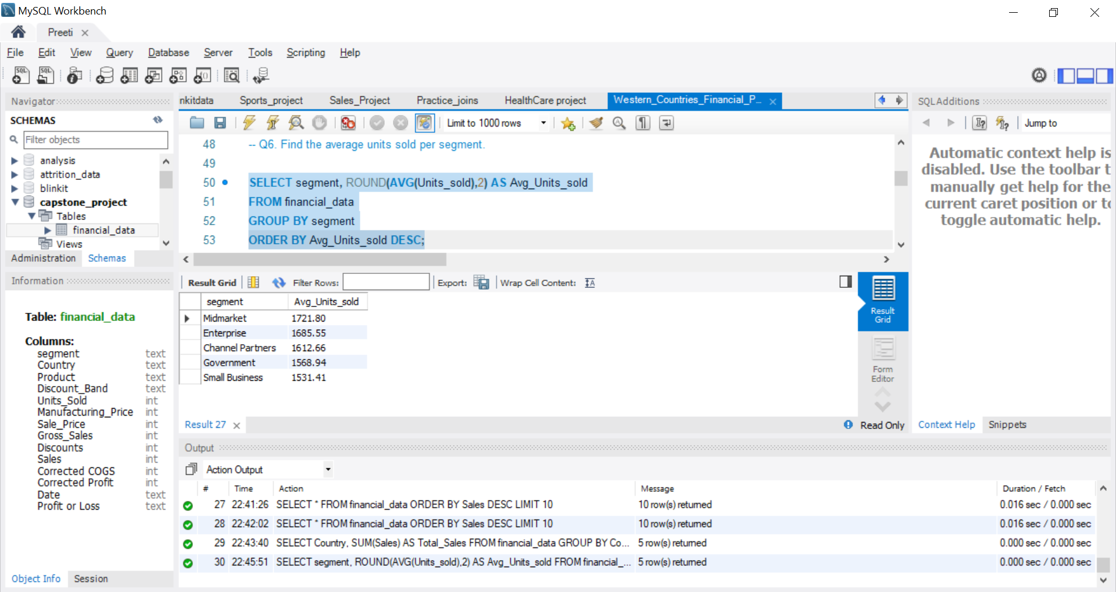

Slide 14
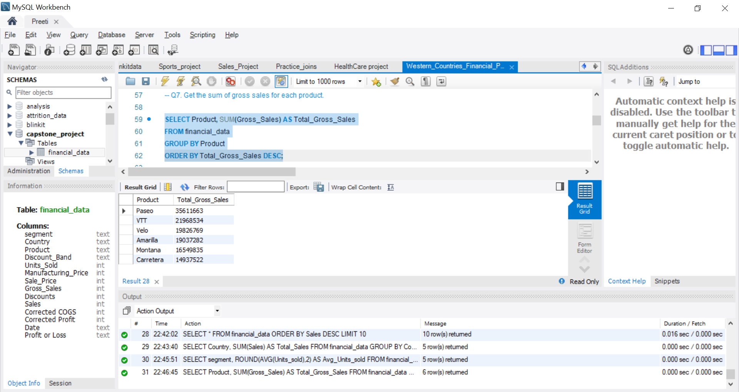

Slide 15
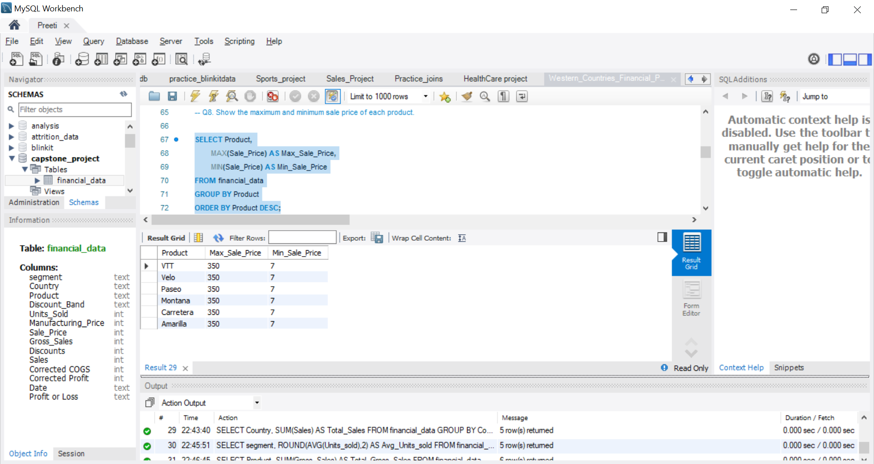

Slide 16
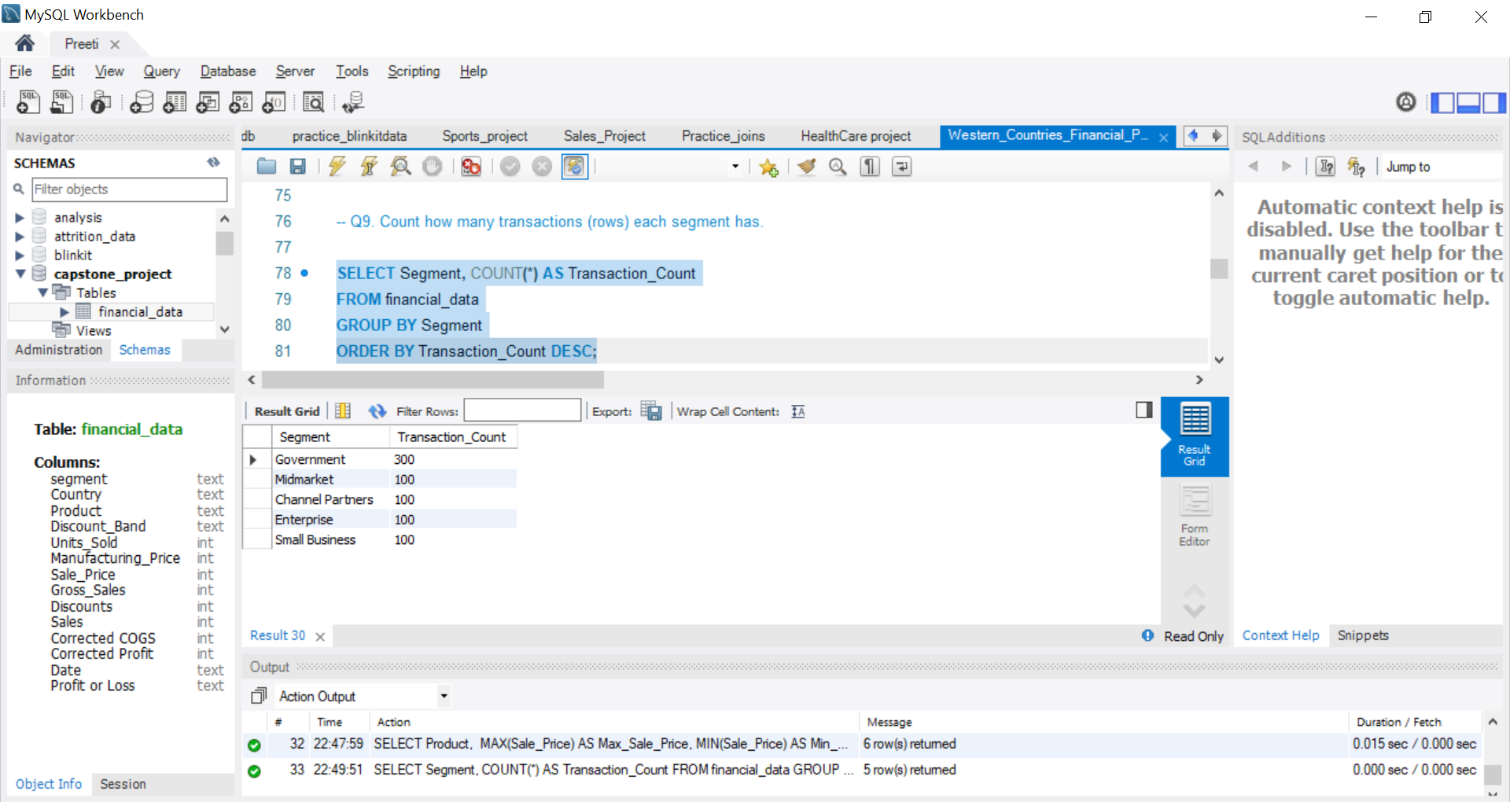

Slide 17
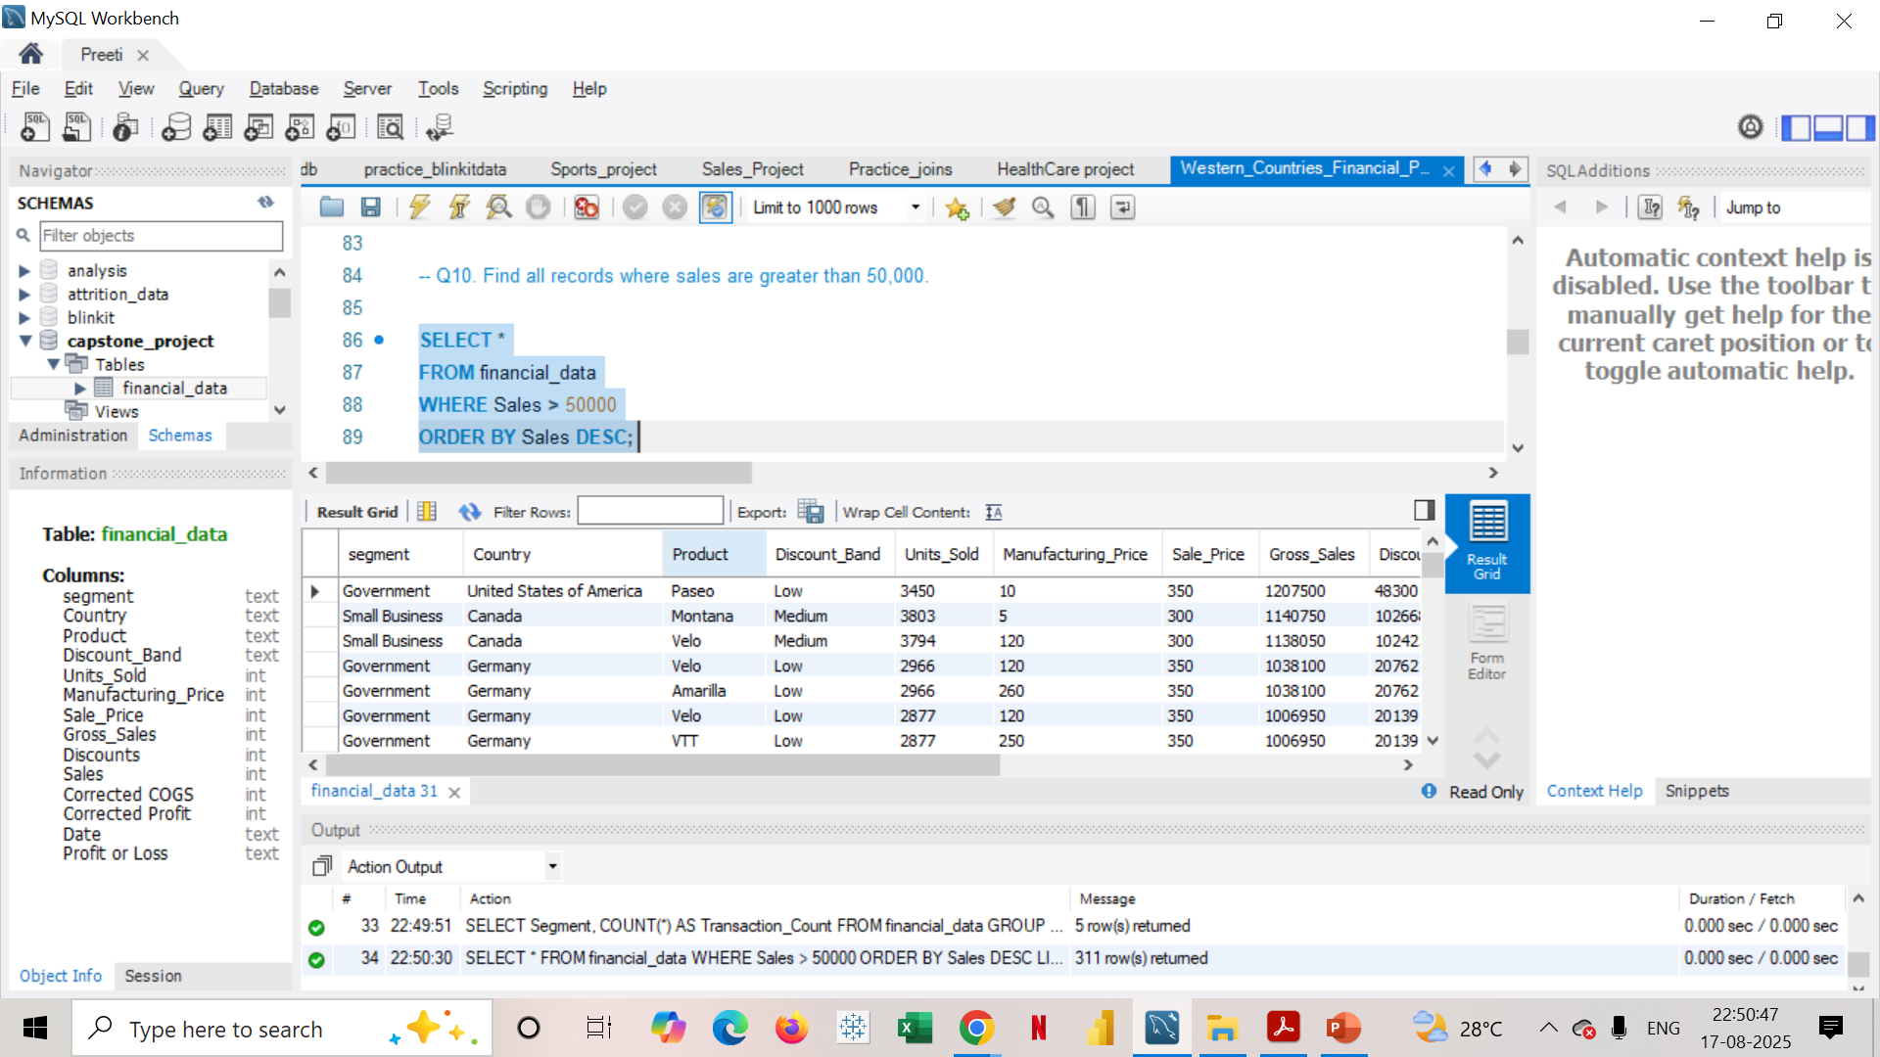

Slide 18
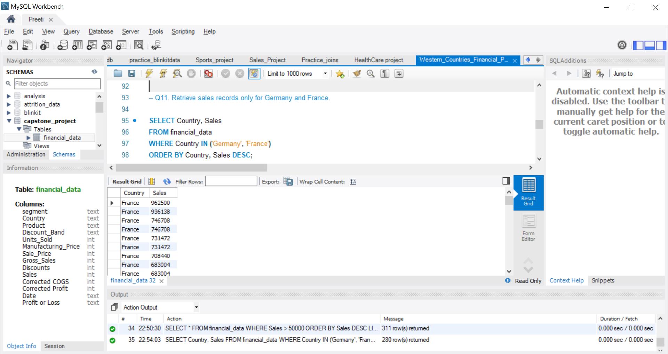

Slide 19
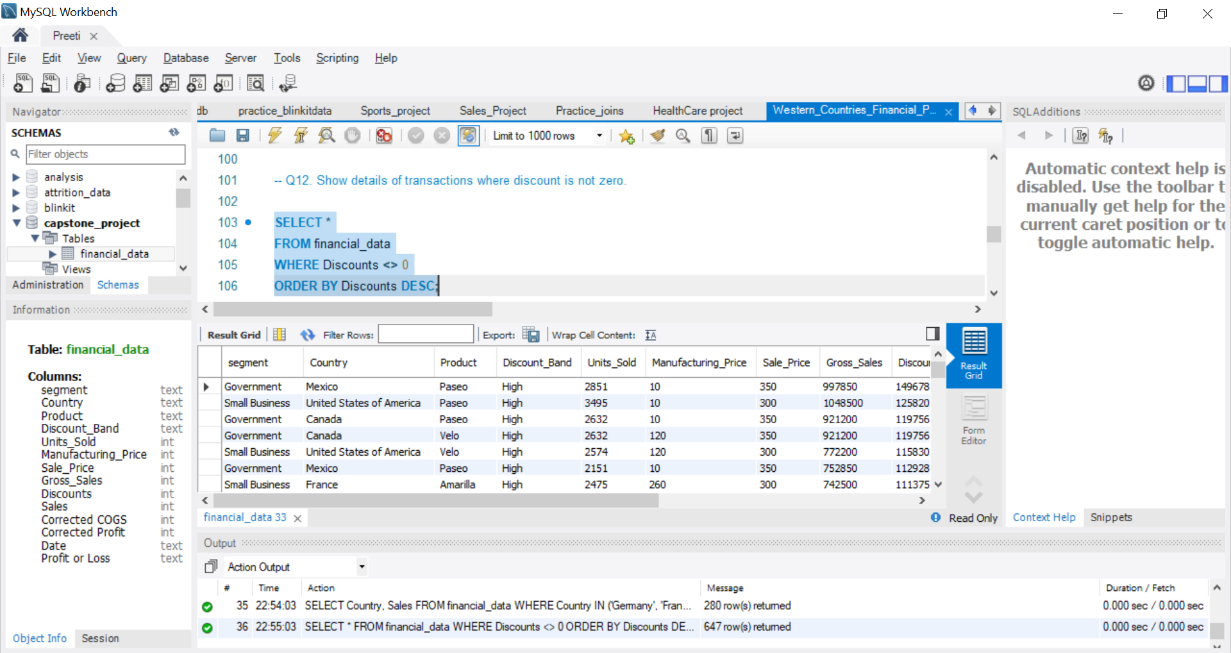

Slide 20
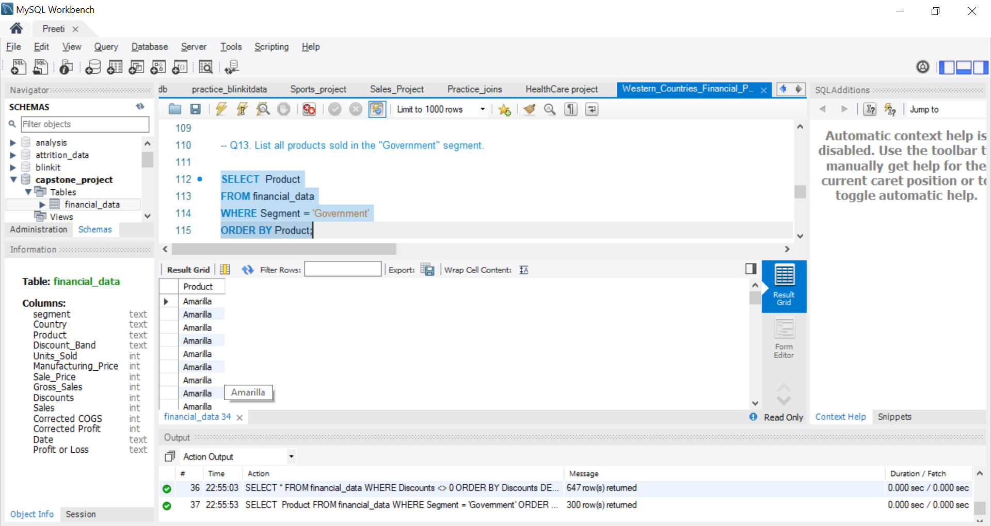

Slide 21
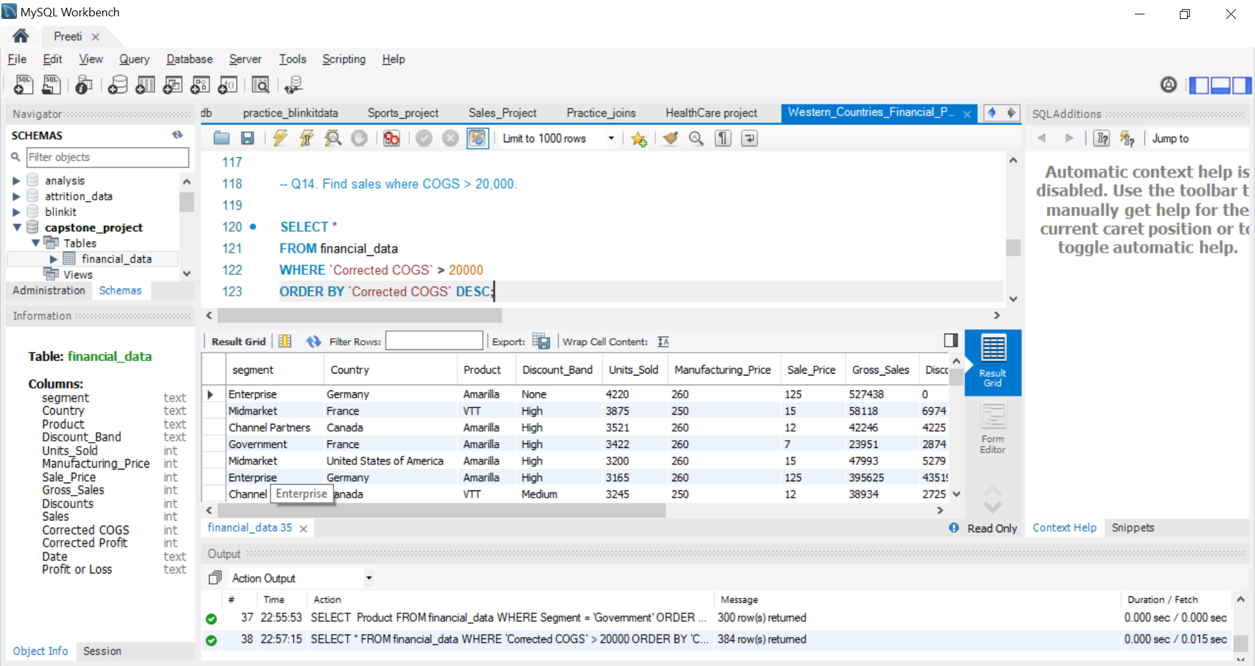

Slide 22
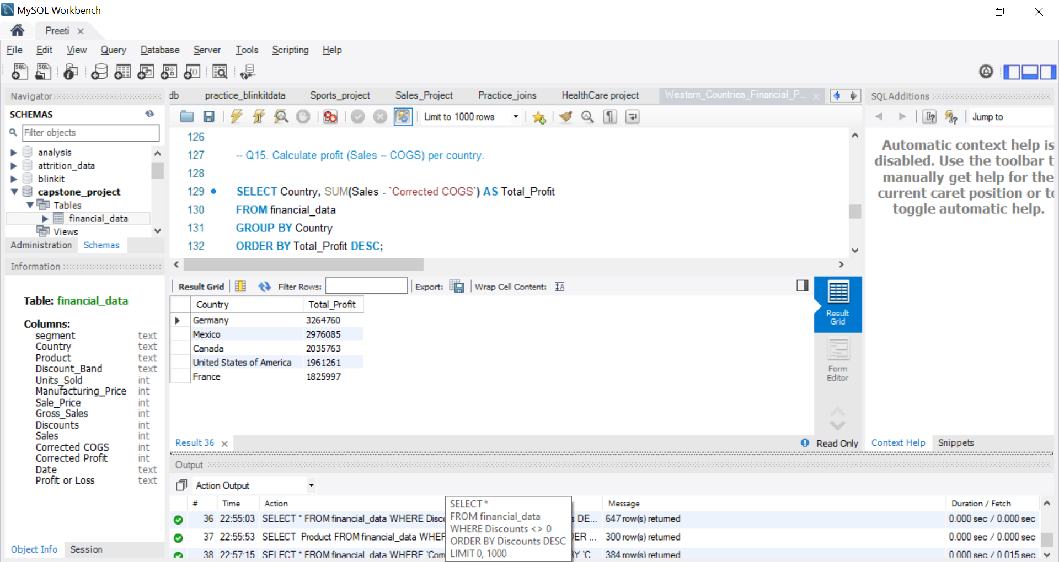

Slide 23
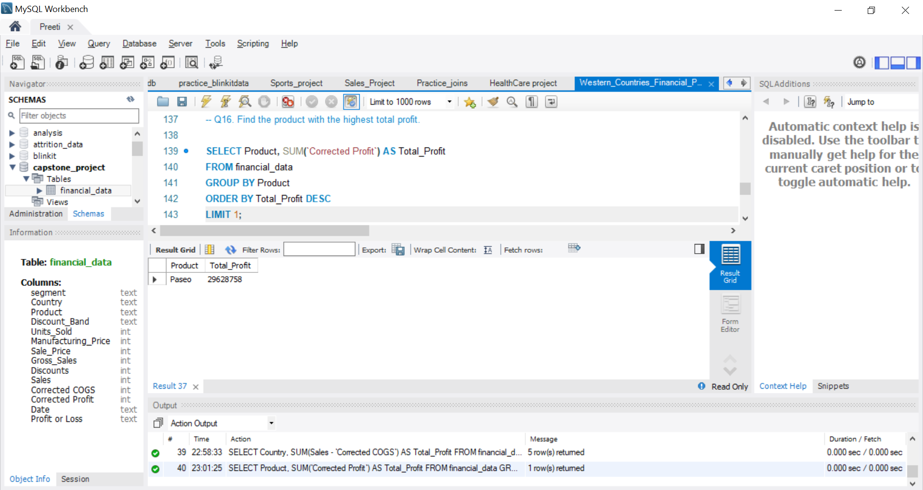

Slide 24
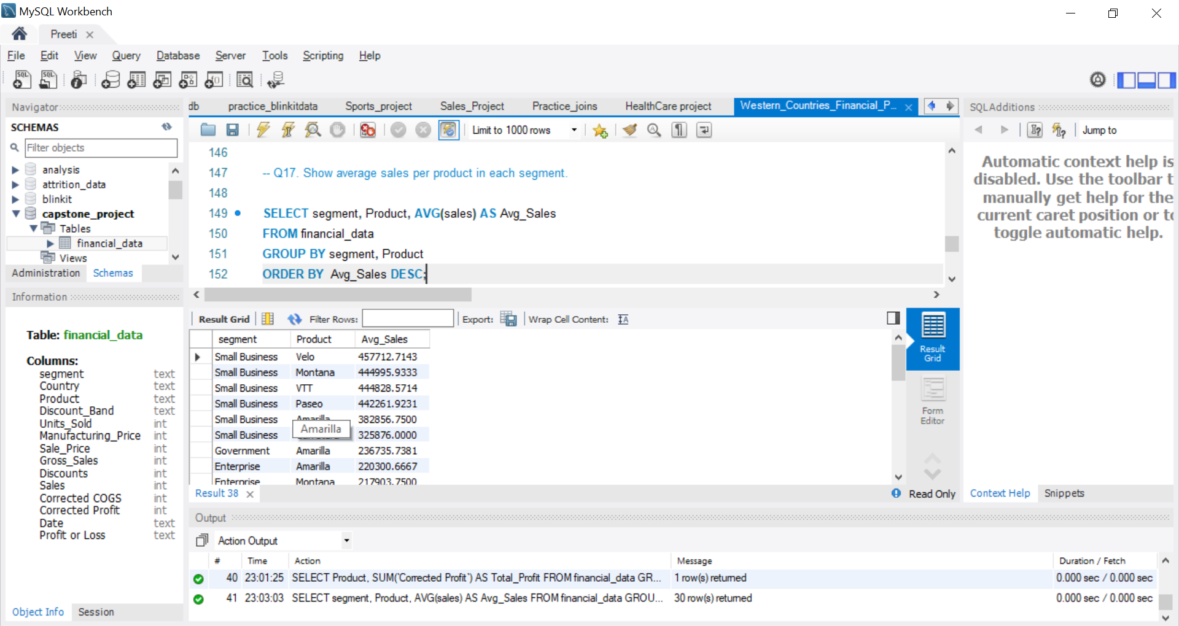

Slide 25
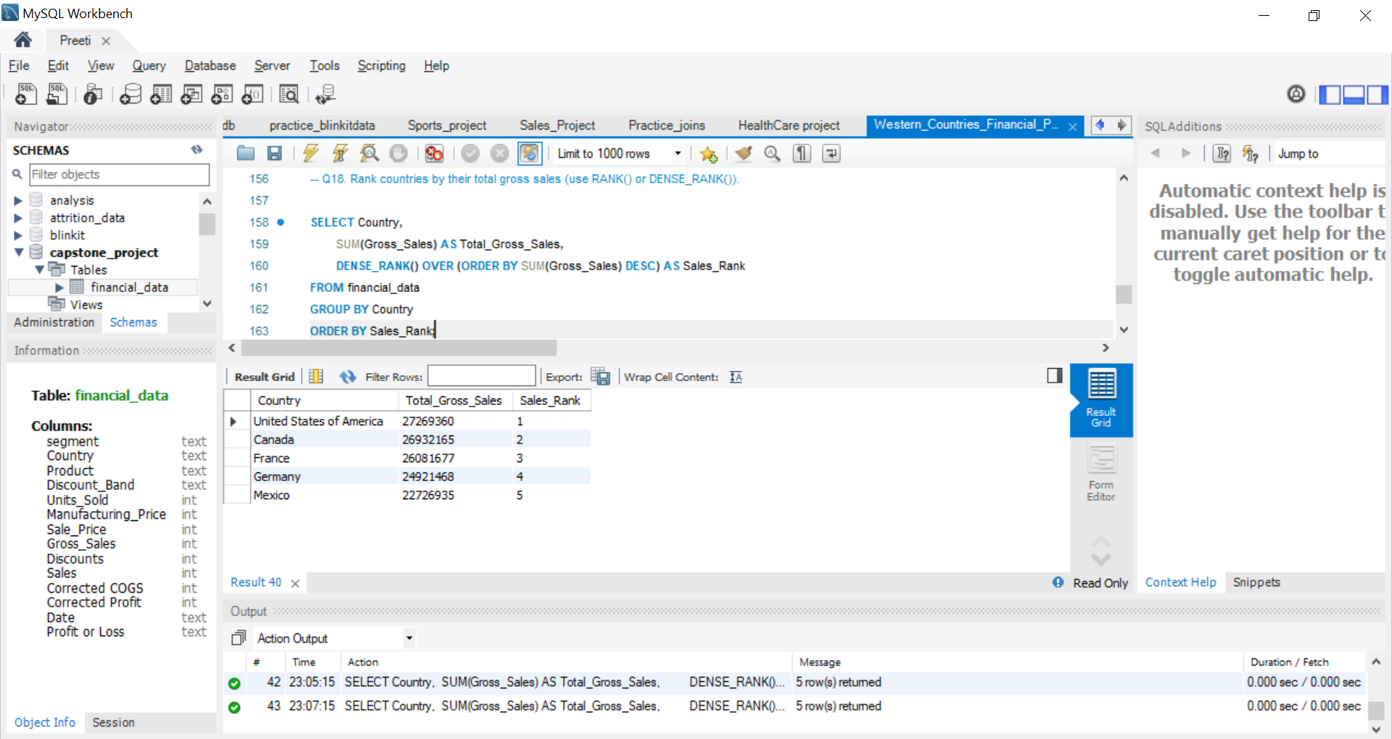

Slide 26
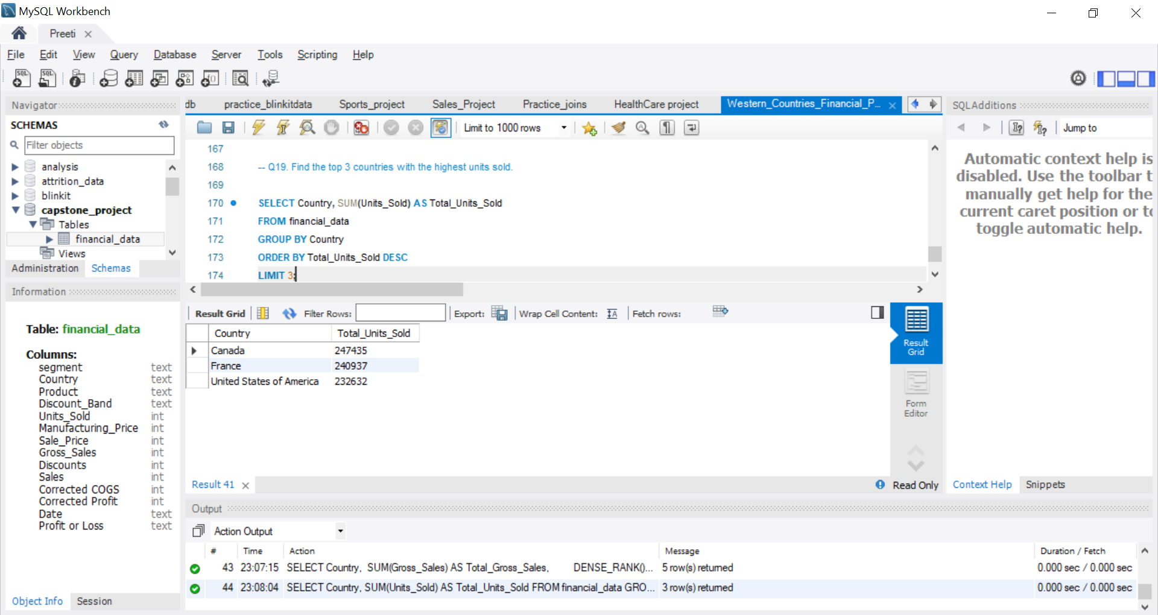

Slide 27
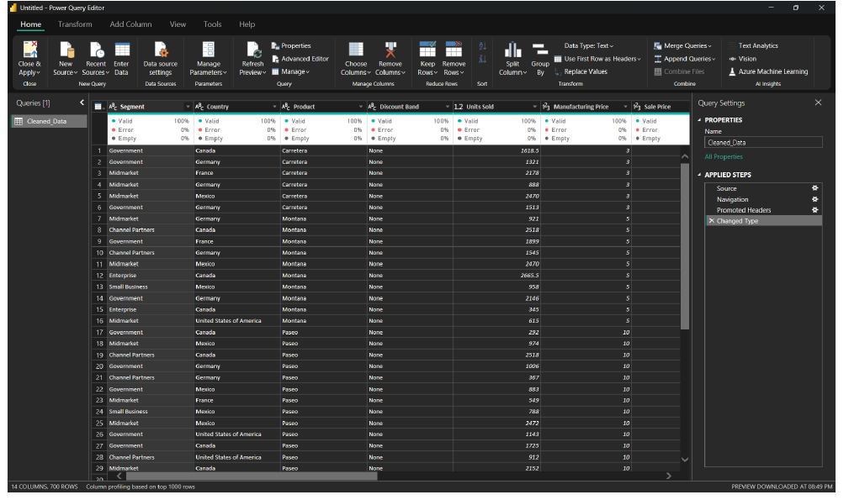
Import the Data from the SQL Database into PowerBI ,verify if the data is properly imported or not.

Slide 28
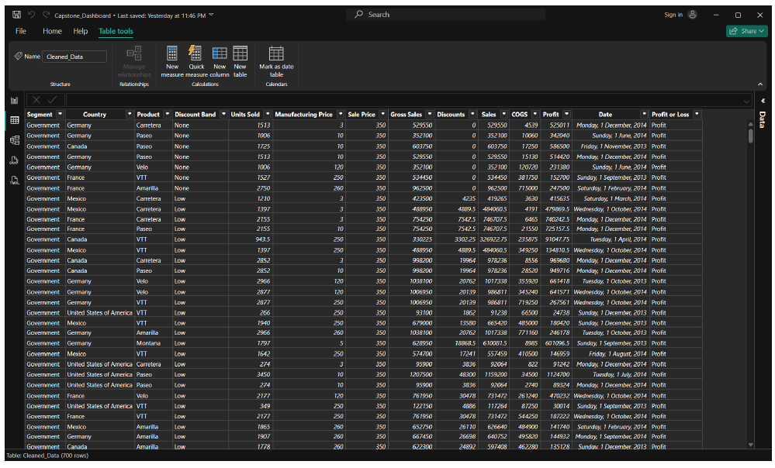
PERFORM DATA CLEANING AND OTHER POSSIBLE OPERATIONS ON DATA USING QUERY EDITOR, CREATE MEASURES IF NECESSARY AND USE THEM TO VISUALIZE THE DATA AND MAKE AN INTERACTIVE VISUALIZATION.

Slide 29
Create a Visually pleasing Dashboard report by following the rules of making the Dashboard.

Slide 30
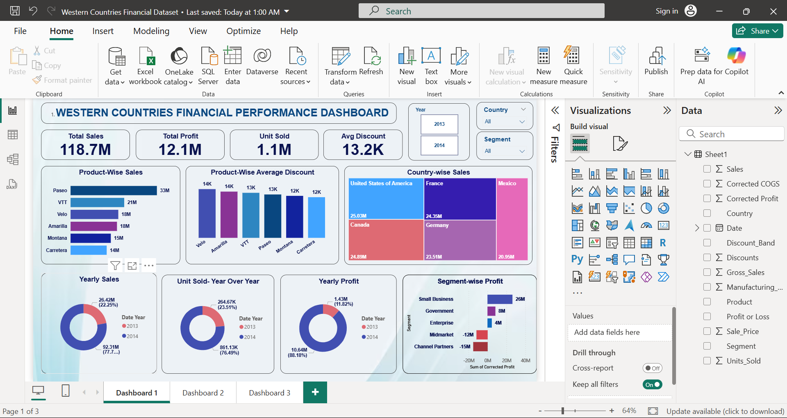

Slide 31
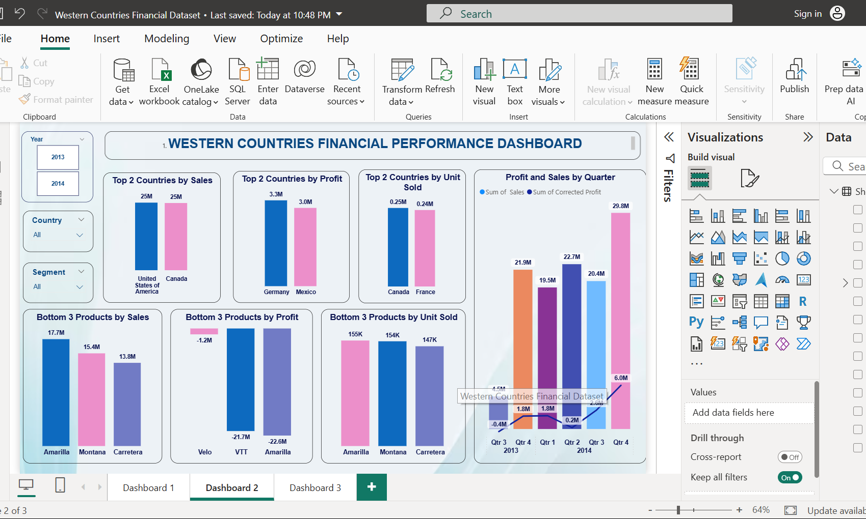

Slide 32
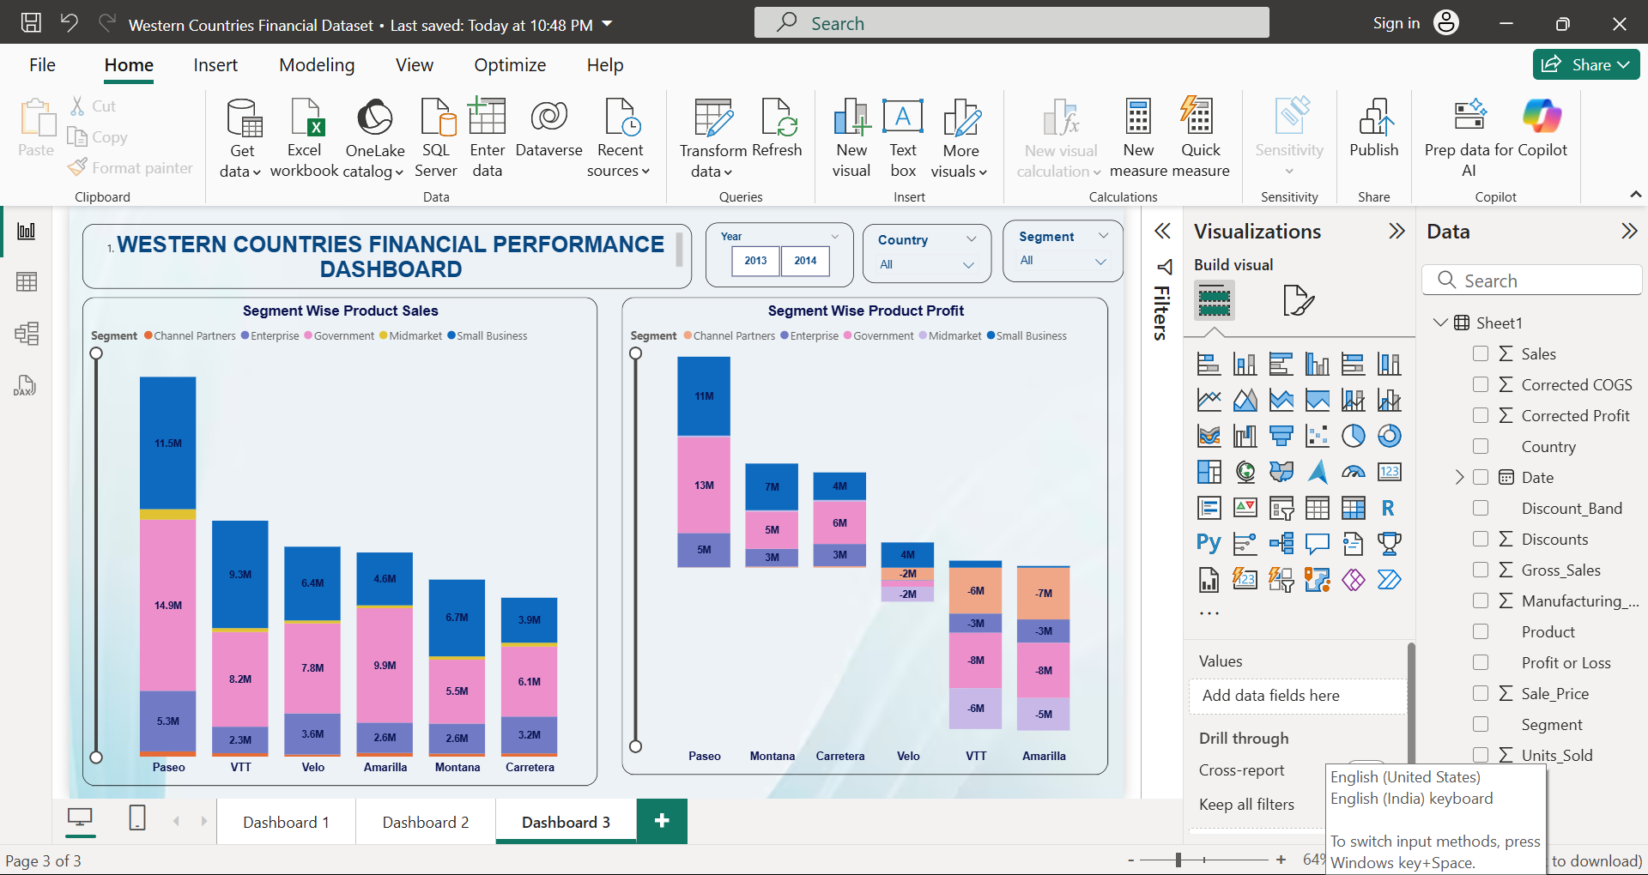

Slide 33
Derive Conclusion and Inferences from the Dashboard.
Executive Snapshot
Scale: 1.13M units → $118.7M sales → $12.1M profit, delivering a 10.2% margin (≈ $105 revenue and $10.7 profit per unit).
Momentum: From 2013 to 2014, sales surged +249% (26.4M → 92.3M) and profit jumped +644% (1.4M → 10.6M). Margins nearly doubled (5.4% → 11.5%).
Profitability drivers: Germany (3.3M) and Mexico (3.0M) top the profit list, despite not being the largest revenue contributors. Margins in USA/Canada look under pressure.
Key issue: Amarilla (-23M) and VTT (-22M) are eroding profits significantly, even though they generate strong sales.

Slide 34
Derive Conclusion and Inferences from the Dashboard.
Growth & Seasonality
Peak quarter: Q4-2014 with $29.8M sales and $6.0M profit.
Weakest: Q3-2013, posting a loss of ~$0.4M.
Risk zone: Q2-2014 delivered $22.7M sales but almost no profit (~$0.2M) → suggests excessive discounting or cost spikes.

Slide 35
Derive Conclusion and Inferences from the Dashboard.
Geographic Insights
Revenue is evenly distributed across the top five markets: USA (25.0M), Canada (24.9M), France (24.4M), Germany (23.5M), Mexico (21.0M).
Profit, however, is concentrated in Germany and Mexico. The USA and Canada lead in sales and units but contribute weaker margins → likely pricing or discount-related issues.
Units sold: Canada (~250K) and France (~240K) lead volumes, yet don’t rank high in profit → pointing to thin margins.

Slide 36
Derive Conclusion and Inferences from the Dashboard.
Segment Profitability – The Big Lever
Small Business is the core profit engine (+26M).
Government (+8M) and Enterprise (+4M) are healthy contributors.
Midmarket (-12M) and Channel Partners (-15M) are major value destroyers. 👉 If these two segments merely broke even, overall profit would jump from ~12M to ~39M — a transformative shift.

Slide 37
Derive Conclusion and Inferences from the Dashboard.
Product Performance & Discounting
Top revenue driver: Paseo ($33M, ~28% of sales), followed by VTT (21M), Velo/Amarilla (18M each), Montana (15M), Carretera (14M).
But profitability tells a different story: Amarilla (-23M), VTT (-22M), and Velo (-1M) are destroying value despite high sales.
Discount effect: The highest-discounted SKUs (Velo, Amarilla, VTT) are also the least profitable. Carretera, with the lowest discount (~12.1K), avoids losses.
Within segments, profitability swings sharply — some products deliver strong profits in Government/Small Business, but incur heavy losses in Midmarket/Channel Partners. Aligning product–segment strategy is critical.

Slide 38
Derive Conclusion and Inferences from the Dashboard.
Unit Economics & Mix
2014 contributes ~76% of units (861K/1.13M), showing growth was volume-led but also margin-accretive — a positive sign.
Bottom-3 by units: Amarilla (155K), Montana (154K), Carretera (147K). However, low volume ≠ poor performance — Carretera earns healthier margins due to lower discounting.

Slide 39
Derive Conclusion and Inferences from the Dashboard.
Likely Root Causes
Over-discounting on Amarilla, VTT, and Velo, amplified in Midmarket and Channel Partners.
Geographic mix issues — USA/Canada deliver scale but weaker margins vs Germany/Mexico (pricing, logistics, or product mix).
Segment misalignment — wrong SKUs being pushed into Midmarket/Channel Partners, where they are unprofitable.

